Slide 1

CSCI 132: Basic Data Structures and Algorithms
Growth Rates
Reese Pearsall
Spring 2025
https://www.cs.montana.edu/pearsall/classes/spring2025/132/main.html

Slide 2

Announcements
Lab 7 due tomorrow at 11:59 pm
Program 2 due next Friday
Midterm Exam is next week
Study guide will be posted soon
No lab next week

Slide 3
As computer scientists, we write many algorithms
We want to be able to describe how well our algorithms perform on a variety of inputs

Slide 4

As computer scientists, we write many algorithms
We want to be able to describe how well our algorithms perform on a variety of inputs
How could measure the effectiveness and performance of our cake making algorithm?
Consider an algorithm that will make a cake

Slide 5
Consider an algorithm that will make a cake
What are some ways we could measure the performance and effectiveness of our algorithm ?
What is the total time needed to make the cake?
Prep time
Combining ingredients
Baking
Cooling
Icing
The time an algorithm takes to finish is important. We generally want our algorithms to run as fast as possible

Slide 6



Consider an algorithm that will make a cake
What are some ways we could measure the performance and effectiveness of our algorithm ?
How well does our algorithm work on a variety of problems?
Suppose we needed to make different types of cake, How well would our algorithm do?
Generalizability and Reliability

Slide 7

Consider an algorithm that will make a cake
What are some ways we could measure the performance and effectiveness of our algorithm ?
How well does our cake taste?
We want our algorithm to output the best cake possible
Does our algorithm always yield the optimal result ?

Slide 8
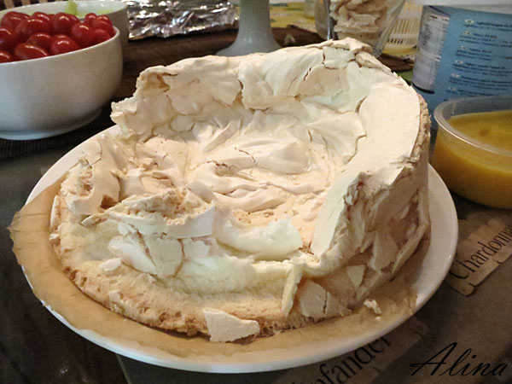
Consider an algorithm that will make a cake
What are some ways we could measure the performance and effectiveness of our algorithm ?
Does our algorithm actually make a cake?
Does our algorithm actually do what we say it does?
Our algorithm needs to be valid

Slide 9

Consider an algorithm that will make a cake
What are some ways we could measure the performance and effectiveness of our algorithm ?
Suppose we needed to make a lot of the same cake
How well does our algorithm scale?

Slide 10
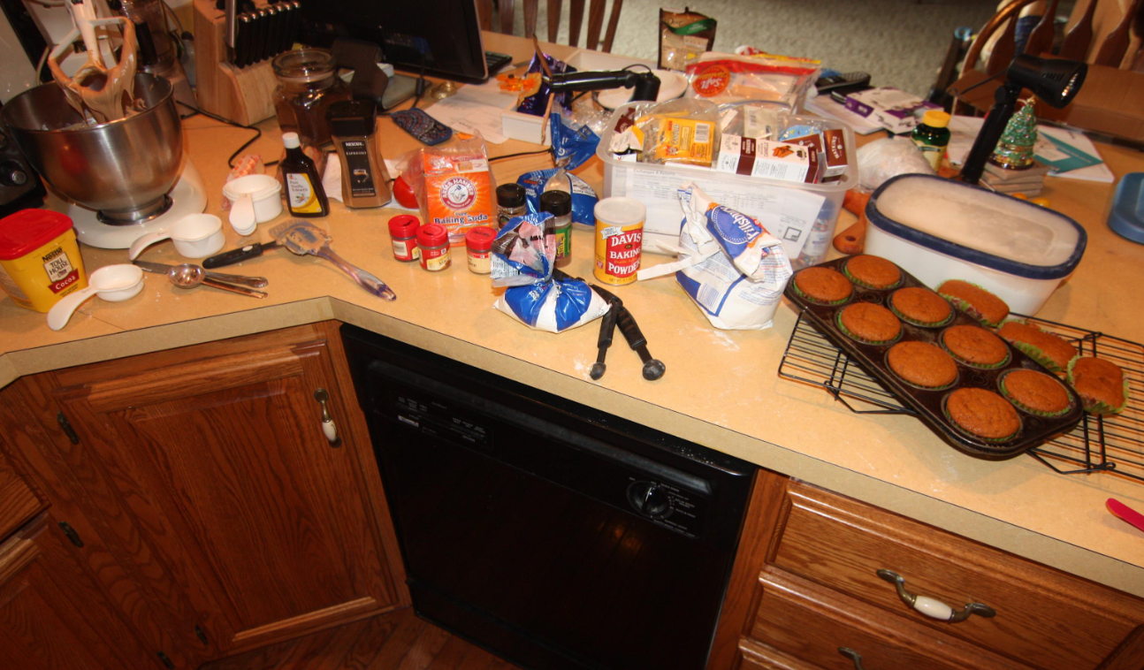
Consider an algorithm that will make a cake
What are some ways we could measure the performance and effectiveness of our algorithm ?
How much kitchen space is needed to make the cake?
What if the cake needed is really big?

Slide 11
Algorithm Analysis
Algorithm Correctness
Validity
Optimality
Generalizability
Performance & Efficiency
Running time of Algorithm
Space needed to run the algorithm

Slide 12
Algorithm Analysis
Algorithm Correctness
Validity
Optimality
Generalizability
Performance & Efficiency
Running time of Algorithm
Space needed to run the algorithm
Important: How well does the algorithm do as the problem gets bigger? (Scalability)

Slide 13
The growth rate of the algorithm looks at how much more resource an algorithm needs (time or space) as the input size increases
(In this class, we will be focusing on time)

Slide 14


Running time issues
The easiest way I could prove the running time of an algorithm is by starting a stopwatch when the algorithm starts, and stop when algorithm finishes
This is not a very good way to accurately show the running time because …

Slide 15
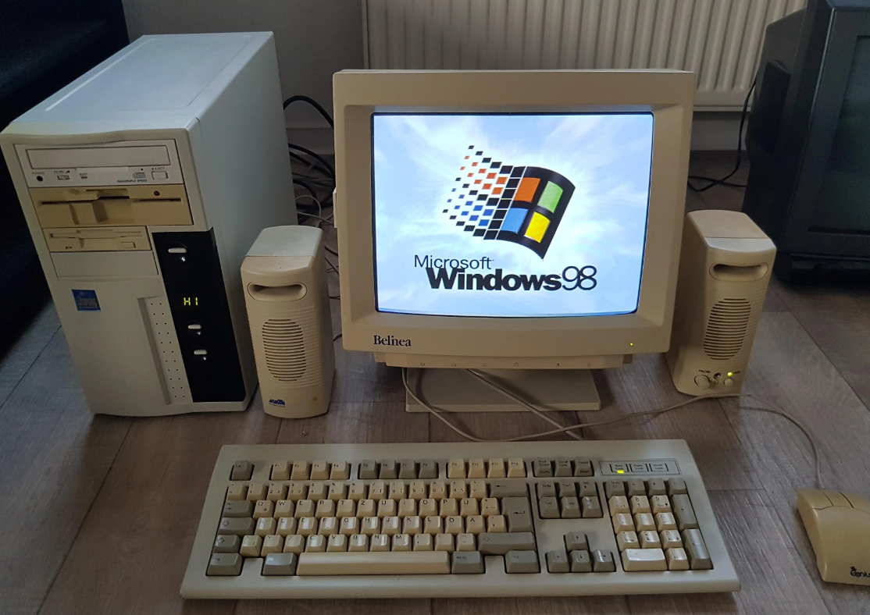
Running time issues
The easiest way I could prove the running time of an algorithm is by starting a stopwatch when the algorithm starts, and stop when algorithm finishes
This is not a very good way to accurately show the running time because …
What if this is my computer?

Slide 16




Running time issues
Issue: The time needed to run an algorithm varies depending on the hardware of computer that is running the algorithm

Slide 17
Running time issues
Issue: The time needed to run an algorithm varies depending on the hardware of computer that is running the algorithm
Instead of focusing on the actual time needed to run an algorithm (seconds), we will look at the number of steps/instructions in the algorithm that need be executed as the input grows!

Slide 18
The growth rate of the algorithm looks at how much more resource an algorithm needs (time or space) as the input size increases
???
???
We will look at 4 growth rates today
The remaining four will be covered later this semester
???
???
???
???
???
???

Slide 19
Algorithm #1: Finding the Maximum Value in an Array
public int find_max_value(int[] array) {
int largest_so_far = -1;
for(int i = 0; i < array.length; i++) {
if ( array[i] > largest_so_far ) {
largest_so_far = array[i];
}
}
return largest_so_far;
}
This algorithm will find the largest value in some N sized array

Slide 20



Algorithm #1: Finding the Maximum Value in an Array
public int find_max_value(int[] array) {
int largest_so_far = -1;
for(int i = 0; i < array.length; i++) {
if ( array[i] > largest_so_far ) {
largest_so_far = array[i];
}
}
return largest_so_far;
}
This algorithm will find the largest value in some N sized array
This code checks each spot in the array

Slide 21



Algorithm #1: Finding the Maximum Value in an Array
public int find_max_value(int[] array) {
int largest_so_far = -1;
for(int i = 0; i < array.length; i++) {
if ( array[i] > largest_so_far ) {
largest_so_far = array[i];
}
}
return largest_so_far;
}
This algorithm will find the largest value in some N sized array
This code checks each spot in the array
Let’s look at how many times this instruction is executed as the array size grows

Slide 22
Algorithm #1: Finding the Maximum Value in an Array
public int find_max_value(int[] array) {
int largest_so_far = -1;
for(int i = 0; i < array.length; i++) {
if ( array[i] > largest_so_far ) {
largest_so_far = array[i];
}
}
return largest_so_far;
}
Array Size
Number of Spots Checked
10

Slide 23
Algorithm #1: Finding the Maximum Value in an Array
public int find_max_value(int[] array) {
int largest_so_far = -1;
for(int i = 0; i < array.length; i++) {
if ( array[i] > largest_so_far ) {
largest_so_far = array[i];
}
}
return largest_so_far;
}
Array Size
Number of Spots Checked
10 | 10

Slide 24
Algorithm #1: Finding the Maximum Value in an Array
public int find_max_value(int[] array) {
int largest_so_far = -1;
for(int i = 0; i < array.length; i++) {
if ( array[i] > largest_so_far ) {
largest_so_far = array[i];
}
}
return largest_so_far;
}
Array Size
Number of Spots Checked
10 | 10
100

Slide 25
Algorithm #1: Finding the Maximum Value in an Array
public int find_max_value(int[] array) {
int largest_so_far = -1;
for(int i = 0; i < array.length; i++) {
if ( array[i] > largest_so_far ) {
largest_so_far = array[i];
}
}
return largest_so_far;
}
Array Size
Number of Spots Checked
10 | 10
100 | 100

Slide 26
Algorithm #1: Finding the Maximum Value in an Array
public int find_max_value(int[] array) {
int largest_so_far = -1;
for(int i = 0; i < array.length; i++) {
if ( array[i] > largest_so_far ) {
largest_so_far = array[i];
}
}
return largest_so_far;
}
Array Size
Number of Spots Checked
10 | 10
100 | 100
533 | 533

Slide 27
Algorithm #1: Finding the Maximum Value in an Array
public int find_max_value(int[] array) {
int largest_so_far = -1;
for(int i = 0; i < array.length; i++) {
if ( array[i] > largest_so_far ) {
largest_so_far = array[i];
}
}
return largest_so_far;
}
Array Size
Number of Spots Checked
10 | 10
100 | 100
533 | 533
1000 | 1000

Slide 28
Algorithm #1: Finding the Maximum Value in an Array
public int find_max_value(int[] array) {
int largest_so_far = -1;
for(int i = 0; i < array.length; i++) {
if ( array[i] > largest_so_far ) {
largest_so_far = array[i];
}
}
return largest_so_far;
}
Array Size
Number of Spots Checked
10 | 10
100 | 100
533 | 533
1000 | 1000
9999

Slide 29
Algorithm #1: Finding the Maximum Value in an Array
public int find_max_value(int[] array) {
int largest_so_far = -1;
for(int i = 0; i < array.length; i++) {
if ( array[i] > largest_so_far ) {
largest_so_far = array[i];
}
}
return largest_so_far;
}
Array Size
Number of Spots Checked
10 | 10
100 | 100
533 | 533
1000 | 1000
9999 | 9999

Slide 30
Algorithm #1: Finding the Maximum Value in an Array
public int find_max_value(int[] array) {
int largest_so_far = -1;
for(int i = 0; i < array.length; i++) {
if ( array[i] > largest_so_far ) {
largest_so_far = array[i];
}
}
return largest_so_far;
}
Array Size
Number of Spots Checked
10 | 10
100 | 100
533 | 533
1000 | 1000
9999 | 9999
1

Slide 31
Algorithm #1: Finding the Maximum Value in an Array
public int find_max_value(int[] array) {
int largest_so_far = -1;
for(int i = 0; i < array.length; i++) {
if ( array[i] > largest_so_far ) {
largest_so_far = array[i];
}
}
return largest_so_far;
}
Array Size
Number of Spots Checked
10 | 10
100 | 100
533 | 533
1000 | 1000
9999 | 9999
1 | 1

Slide 32
Algorithm #1: Finding the Maximum Value in an Array
public int find_max_value(int[] array) {
int largest_so_far = -1;
for(int i = 0; i < array.length; i++) {
if ( array[i] > largest_so_far ) {
largest_so_far = array[i];
}
}
return largest_so_far;
}
Array Size
Number of Spots Checked
10 | 10
100 | 100
533 | 533
1000 | 1000
9999 | 9999
1 | 1
1000000000

Slide 33
Algorithm #1: Finding the Maximum Value in an Array
public int find_max_value(int[] array) {
int largest_so_far = -1;
for(int i = 0; i < array.length; i++) {
if ( array[i] > largest_so_far ) {
largest_so_far = array[i];
}
}
return largest_so_far;
}
Array Size
Number of Spots Checked
10 | 10
100 | 100
533 | 533
1000 | 1000
9999 | 9999
1 | 1
1000000000 | 1000000000

Slide 34
Algorithm #1: Finding the Maximum Value in an Array
public int find_max_value(int[] array) {
int largest_so_far = -1;
for(int i = 0; i < array.length; i++) {
if ( array[i] > largest_so_far ) {
largest_so_far = array[i];
}
}
return largest_so_far;
}
Array Size
Number of Spots Checked
10 | 10
100 | 100
533 | 533
1000 | 1000
9999 | 9999
1 | 1
1000000000 | 1000000000
What if we graphed these points?
(10,10) , (100,100), (533,533), (1000,100) ….

Slide 35
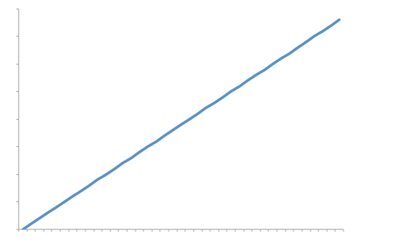
Algorithm #1: Finding the Maximum Value in an Array
public int find_max_value(int[] array) {
int largest_so_far = -1;
for(int i = 0; i < array.length; i++) {
if ( array[i] > largest_so_far ) {
largest_so_far = array[i];
}
}
return largest_so_far;
}
Array Size
Number of Spots Checked
10 | 10
100 | 100
533 | 533
1000 | 1000
9999 | 9999
1 | 1
1000000000 | 1000000000
Array Spots Checked
Array Size (N)

Slide 36
Algorithm #1: Finding the Maximum Value in an Array
public int find_max_value(int[] array) {
int largest_so_far = -1;
for(int i = 0; i < array.length; i++) {
if ( array[i] > largest_so_far ) {
largest_so_far = array[i];
}
}
return largest_so_far;
}
The growth rate of this algorithm is linear
A linear growth rate is a growth rate where the resource needs and the amount of data is directly proportional to each other.
Array Spots Checked
Array Size (N)

Slide 37

Algorithm #1: Finding the Maximum Value in an Array
public int find_max_value(int[] array) {
int largest_so_far = -1;
for(int i = 0; i < array.length; i++) {
if ( array[i] > largest_so_far ) {
largest_so_far = array[i];
}
}
return largest_so_far;
}
The growth rate of this algorithm is linear
A linear growth rate is a growth rate where the resource needs and the amount of data is directly proportional to each other.
The driving factor of this algorithm is the size of the array
As N increases, the number of steps executed in this algorithm linearly increases
Array Spots Checked
F(N) = N
Array Size (N)

Slide 38
Algorithm #2: Printing out an N x N 2D Array
public void print2Darray(int[][] array) {
for(int[] x: array) {
for(int y: x) {
System.out.print(y);
}
System.out.println();
}
}
Given an N x N 2D array, print out its contents

Slide 39
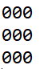
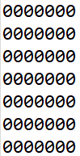
Algorithm #2: Printing out an N x N 2D Array
public void print2Darray(int[][] array) {
for(int[] x: array) {
for(int y: x) {
System.out.print(y);
}
System.out.println();
}
}
Given an N x N 2D array, print out its contents
N = 3
N = 7

Slide 40

Algorithm #2: Printing out an N x N 2D Array
public void print2Darray(int[][] array) {
for(int[] x: array) {
for(int y: x) {
System.out.print(y);
}
System.out.println();
}
}
Given an N x N 2D array, print out its contents
Let’s look at how many times this operation is executed as N increases
N = 3
N = 7

Slide 41
Algorithm #2: Printing out an N x N 2D Array
public void print2Darray(int[][] array) {
for(int[] x: array) {
for(int y: x) {
System.out.print(y);
}
System.out.println();
}
}
N
Number of Array Spots Printed out

Slide 42
Algorithm #2: Printing out an N x N 2D Array
public void print2Darray(int[][] array) {
for(int[] x: array) {
for(int y: x) {
System.out.print(y);
}
System.out.println();
}
}
N
Number of Array Spots Printed out
1

Slide 43
Algorithm #2: Printing out an N x N 2D Array
public void print2Darray(int[][] array) {
for(int[] x: array) {
for(int y: x) {
System.out.print(y);
}
System.out.println();
}
}
N
Number of Array Spots Printed out
1 | 1

Slide 44
Algorithm #2: Printing out an N x N 2D Array
public void print2Darray(int[][] array) {
for(int[] x: array) {
for(int y: x) {
System.out.print(y);
}
System.out.println();
}
}
N
Number of Array Spots Printed out
1 | 1
2 | 4

Slide 45
Algorithm #2: Printing out an N x N 2D Array
public void print2Darray(int[][] array) {
for(int[] x: array) {
for(int y: x) {
System.out.print(y);
}
System.out.println();
}
}
N
Number of Array Spots Printed out
1 | 1
2 | 4
3

Slide 46
Algorithm #2: Printing out an N x N 2D Array
public void print2Darray(int[][] array) {
for(int[] x: array) {
for(int y: x) {
System.out.print(y);
}
System.out.println();
}
}
N
Number of Array Spots Printed out
1 | 1
2 | 4
3 | 9

Slide 47
Algorithm #2: Printing out an N x N 2D Array
public void print2Darray(int[][] array) {
for(int[] x: array) {
for(int y: x) {
System.out.print(y);
}
System.out.println();
}
}
N
Number of Array Spots Printed out
1 | 1
2 | 4
3 | 9
4

Slide 48
Algorithm #2: Printing out an N x N 2D Array
public void print2Darray(int[][] array) {
for(int[] x: array) {
for(int y: x) {
System.out.print(y);
}
System.out.println();
}
}
N
Number of Array Spots Printed out
1 | 1
2 | 4
3 | 9
4 | 16

Slide 49
Algorithm #2: Printing out an N x N 2D Array
public void print2Darray(int[][] array) {
for(int[] x: array) {
for(int y: x) {
System.out.print(y);
}
System.out.println();
}
}
N
Number of Array Spots Printed out
1 | 1
2 | 4
3 | 9
4 | 16
5 | 25

Slide 50
Algorithm #2: Printing out an N x N 2D Array
public void print2Darray(int[][] array) {
for(int[] x: array) {
for(int y: x) {
System.out.print(y);
}
System.out.println();
}
}
N
Number of Array Spots Printed out
1 | 1
2 | 4
3 | 9
4 | 16
5 | 25
… | …
100 | 10000

Slide 51
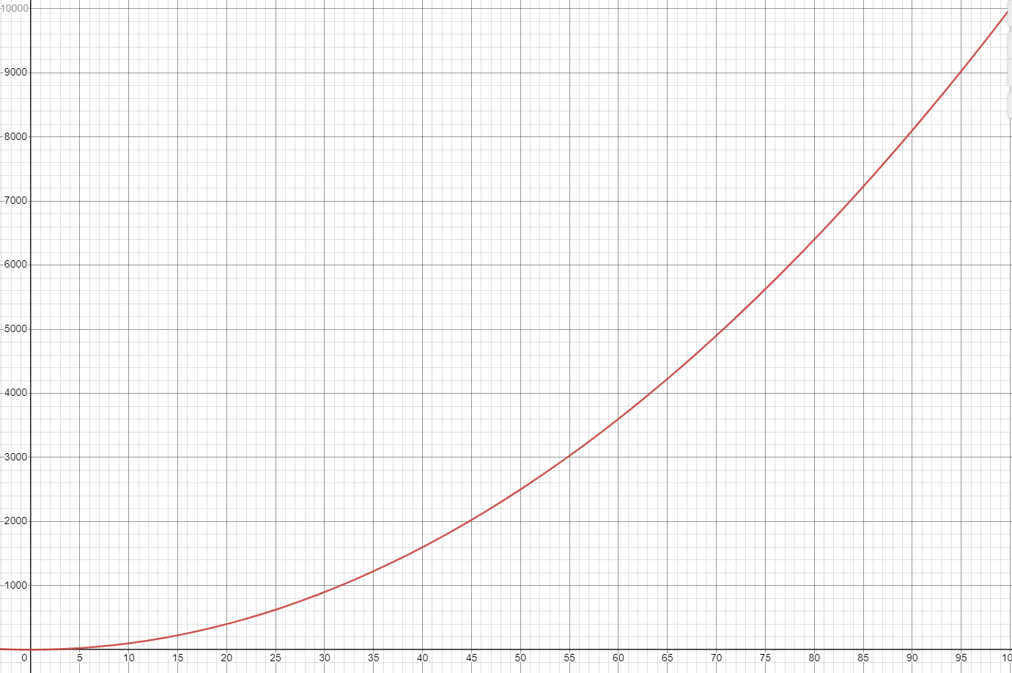
Algorithm #2: Printing out an N x N 2D Array
public void print2Darray(int[][] array) {
for(int[] x: array) {
for(int y: x) {
System.out.print(y);
}
System.out.println();
}
}
N
Number of Array Spots Printed out
1 | 1
2 | 4
3 | 9
4 | 16
5 | 25
… | …
100 | 10000
Number of Array Spots Printed out
N

Slide 52
Algorithm #2: Printing out an N x N 2D Array
public void print2Darray(int[][] array) {
for(int[] x: array) {
for(int y: x) {
System.out.print(y);
}
System.out.println();
}
}
The growth rate of this algorithm is quadratic
A quadratic growth rate is a growth rate where the resource needs and the amount of data is proportional to the square of a function
Number of Array Spots Printed out
N

Slide 53
Algorithm #2: Printing out an N x N 2D Array
public void print2Darray(int[][] array) {
for(int[] x: array) {
for(int y: x) {
System.out.print(y);
}
System.out.println();
}
}
The growth rate of this algorithm is quadratic
A quadratic growth rate is a growth rate where the resource needs and the amount of data is proportional to the square of a function
F(x) = X ^ 2
Number of Array Spots Printed out
We have a for loop inside of a for loop, so as N increases, the number of times the inside for loop executes = N * N
N

Slide 54
Algorithm #3: Adding a node to front of linked list
public void addToFront(Node newNode) {
newNode.setNext(this.head);
this.head = newNode;
}

Slide 55
Algorithm #3: Adding a node to front of linked list
public void addToFront(Node newNode) {
newNode.setNext(this.head);
this.head = newNode;
}
Given a singly linked list (with at least one node), this algorithm adds a new node to the front of the LL

Slide 56
Algorithm #3: Adding a node to front of linked list
public void addToFront(Node newNode) {
newNode.setNext(this.head);
this.head = newNode;
}
Given a singly linked list (with at least one node), this algorithm adds a new node to the front of the LL

Slide 57
Algorithm #3: Adding a node to front of linked list
public void addToFront(Node newNode) {
newNode.setNext(this.head);
this.head = newNode;
}
Given a singly linked list (with at least one node), this algorithm adds a new node to the front of the LL
This algorithm consists of two operations. Let’s look at how many times these operations are executed as the Linked List size increases

Slide 58
Algorithm #3: Adding a node to front of linked list
public void addToFront(Node newNode) {
newNode.setNext(this.head);
this.head = newNode;
}
N
# of operations executed
N= # of nodes in LL

Slide 59
Algorithm #3: Adding a node to front of linked list
public void addToFront(Node newNode) {
newNode.setNext(this.head);
this.head = newNode;
}
N
# of operations executed
1
N= # of nodes in LL

Slide 60
Algorithm #3: Adding a node to front of linked list
public void addToFront(Node newNode) {
newNode.setNext(this.head);
this.head = newNode;
}
N
# of operations executed
1 | 2
N= # of nodes in LL

Slide 61
Algorithm #3: Adding a node to front of linked list
public void addToFront(Node newNode) {
newNode.setNext(this.head);
this.head = newNode;
}
N
# of operations executed
1 | 2
2
N= # of nodes in LL

Slide 62
Algorithm #3: Adding a node to front of linked list
public void addToFront(Node newNode) {
newNode.setNext(this.head);
this.head = newNode;
}
N
# of operations executed
1 | 2
2 | 2
N= # of nodes in LL

Slide 63
Algorithm #3: Adding a node to front of linked list
public void addToFront(Node newNode) {
newNode.setNext(this.head);
this.head = newNode;
}
N
# of operations executed
1 | 2
2 | 2
3
N= # of nodes in LL

Slide 64
Algorithm #3: Adding a node to front of linked list
public void addToFront(Node newNode) {
newNode.setNext(this.head);
this.head = newNode;
}
N
# of operations executed
1 | 2
2 | 2
3 | 2
N= # of nodes in LL

Slide 65
Algorithm #3: Adding a node to front of linked list
public void addToFront(Node newNode) {
newNode.setNext(this.head);
this.head = newNode;
}
N
# of operations executed
1 | 2
2 | 2
3 | 2
4
N= # of nodes in LL

Slide 66
Algorithm #3: Adding a node to front of linked list
public void addToFront(Node newNode) {
newNode.setNext(this.head);
this.head = newNode;
}
N
# of operations executed
1 | 2
2 | 2
3 | 2
4 | 2
N= # of nodes in LL

Slide 67
Algorithm #3: Adding a node to front of linked list
public void addToFront(Node newNode) {
newNode.setNext(this.head);
this.head = newNode;
}
N
# of operations executed
1 | 2
2 | 2
3 | 2
4 | 2
100
N= # of nodes in LL

Slide 68
Algorithm #3: Adding a node to front of linked list
public void addToFront(Node newNode) {
newNode.setNext(this.head);
this.head = newNode;
}
N
# of operations executed
1 | 2
2 | 2
3 | 2
4 | 2
100 | 2
N= # of nodes in LL

Slide 69
Algorithm #3: Adding a node to front of linked list
public void addToFront(Node newNode) {
newNode.setNext(this.head);
this.head = newNode;
}
N
# of operations executed
1 | 2
2 | 2
3 | 2
4 | 2
100 | 2
777
N= # of nodes in LL

Slide 70
Algorithm #3: Adding a node to front of linked list
public void addToFront(Node newNode) {
newNode.setNext(this.head);
this.head = newNode;
}
N
# of operations executed
1 | 2
2 | 2
3 | 2
4 | 2
100 | 2
777 | 2
N= # of nodes in LL

Slide 71
Algorithm #3: Adding a node to front of linked list
public void addToFront(Node newNode) {
newNode.setNext(this.head);
this.head = newNode;
}
N
# of operations executed
1 | 2
2 | 2
3 | 2
4 | 2
100 | 2
777 | 2
1000000000
N= # of nodes in LL

Slide 72
Algorithm #3: Adding a node to front of linked list
public void addToFront(Node newNode) {
newNode.setNext(this.head);
this.head = newNode;
}
N
# of operations executed
1 | 2
2 | 2
3 | 2
4 | 2
100 | 2
777 | 2
1000000000 | 2
N= # of nodes in LL

Slide 73
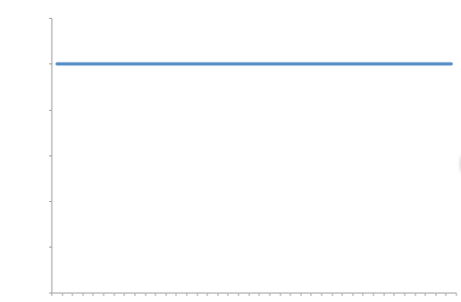
Algorithm #3: Adding a node to front of linked list
public void addToFront(Node newNode) {
newNode.setNext(this.head);
this.head = newNode;
}
N
# of operations executed
1 | 2
2 | 2
3 | 2
4 | 2
100 | 2
777 | 2
1000000000 | 2
# of operations executed
N
N= # of nodes in LL

Slide 74
Algorithm #3: Adding a node to front of linked list
public void addToFront(Node newNode) {
newNode.setNext(this.head);
this.head = newNode;
}
The growth rate of this algorithm is constant
A constant growth rate is one where the resource need does not grow as N increases.
F(x) = 1
# of operations executed
The number of instructions executed for adding something to LL of size 1 is the same as adding to a LL of size 100000000000
ie. As N increases, the number of steps our algorithm performs is constant
N

Slide 75
Algorithm #4: Generating all possible binary combinations of length N

Slide 76
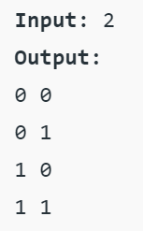
Algorithm #4: Generating all possible binary combinations of length N

Slide 77
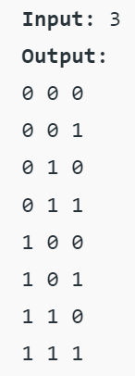
Algorithm #4: Generating all possible binary combinations of length N

Slide 78
Algorithm #4: Generating all possible binary combinations of length N
Input: 4
Output
0000
0001
0010
0011
0100
0101
0110
0111
…
1111

Slide 79
Algorithm #4: Generating all possible binary combinations of length N
static void generateAllBinaryStrings(int n, int arr[], int i) {
if (i == n) {
printTheArray(arr, n);
return;
}
arr[i] = 0;
generateAllBinaryStrings(n, arr, i + 1);
arr[i] = 1;
generateAllBinaryStrings(n, arr, i + 1);
}
Don’t worry too much about the specifics of the algorithm. Let’s look at the amount a string that get generated as N increases

Slide 80
Algorithm #4: Generating all possible binary combinations of length N
static void generateAllBinaryStrings(int n, int arr[], int i) {
if (i == n) {
printTheArray(arr, n);
return;
}
arr[i] = 0;
generateAllBinaryStrings(n, arr, i + 1);
arr[i] = 1;
generateAllBinaryStrings(n, arr, i + 1);
}
N
# Of binary digits generated
1
N = length of binary digits

Slide 81
Algorithm #4: Generating all possible binary combinations of length N
static void generateAllBinaryStrings(int n, int arr[], int i) {
if (i == n) {
printTheArray(arr, n);
return;
}
arr[i] = 0;
generateAllBinaryStrings(n, arr, i + 1);
arr[i] = 1;
generateAllBinaryStrings(n, arr, i + 1);
}
N
# Of binary digits generated
1 | 2
N = length of binary digits

Slide 82
Algorithm #4: Generating all possible binary combinations of length N
static void generateAllBinaryStrings(int n, int arr[], int i) {
if (i == n) {
printTheArray(arr, n);
return;
}
arr[i] = 0;
generateAllBinaryStrings(n, arr, i + 1);
arr[i] = 1;
generateAllBinaryStrings(n, arr, i + 1);
}
N
# Of binary digits generated
1 | 2
2
N = length of binary digits

Slide 83
Algorithm #4: Generating all possible binary combinations of length N
static void generateAllBinaryStrings(int n, int arr[], int i) {
if (i == n) {
printTheArray(arr, n);
return;
}
arr[i] = 0;
generateAllBinaryStrings(n, arr, i + 1);
arr[i] = 1;
generateAllBinaryStrings(n, arr, i + 1);
}
N
# Of binary digits generated
1 | 2
2 | 4
N = length of binary digits

Slide 84
Algorithm #4: Generating all possible binary combinations of length N
static void generateAllBinaryStrings(int n, int arr[], int i) {
if (i == n) {
printTheArray(arr, n);
return;
}
arr[i] = 0;
generateAllBinaryStrings(n, arr, i + 1);
arr[i] = 1;
generateAllBinaryStrings(n, arr, i + 1);
}
N
# Of binary digits generated
1 | 2
2 | 4
3
N = length of binary digits

Slide 85
Algorithm #4: Generating all possible binary combinations of length N
static void generateAllBinaryStrings(int n, int arr[], int i) {
if (i == n) {
printTheArray(arr, n);
return;
}
arr[i] = 0;
generateAllBinaryStrings(n, arr, i + 1);
arr[i] = 1;
generateAllBinaryStrings(n, arr, i + 1);
}
N
# Of binary digits generated
1 | 2
2 | 4
3 | 8
N = length of binary digits

Slide 86
Algorithm #4: Generating all possible binary combinations of length N
static void generateAllBinaryStrings(int n, int arr[], int i) {
if (i == n) {
printTheArray(arr, n);
return;
}
arr[i] = 0;
generateAllBinaryStrings(n, arr, i + 1);
arr[i] = 1;
generateAllBinaryStrings(n, arr, i + 1);
}
N
# Of binary digits generated
1 | 2
2 | 4
3 | 8
4
N = length of binary digits

Slide 87
Algorithm #4: Generating all possible binary combinations of length N
static void generateAllBinaryStrings(int n, int arr[], int i) {
if (i == n) {
printTheArray(arr, n);
return;
}
arr[i] = 0;
generateAllBinaryStrings(n, arr, i + 1);
arr[i] = 1;
generateAllBinaryStrings(n, arr, i + 1);
}
N
# Of binary digits generated
1 | 2
2 | 4
3 | 8
4 | 16
N = length of binary digits

Slide 88
Algorithm #4: Generating all possible binary combinations of length N
static void generateAllBinaryStrings(int n, int arr[], int i) {
if (i == n) {
printTheArray(arr, n);
return;
}
arr[i] = 0;
generateAllBinaryStrings(n, arr, i + 1);
arr[i] = 1;
generateAllBinaryStrings(n, arr, i + 1);
}
N
# Of binary digits generated
1 | 2
2 | 4
3 | 8
4 | 16
5
N = length of binary digits

Slide 89
Algorithm #4: Generating all possible binary combinations of length N
static void generateAllBinaryStrings(int n, int arr[], int i) {
if (i == n) {
printTheArray(arr, n);
return;
}
arr[i] = 0;
generateAllBinaryStrings(n, arr, i + 1);
arr[i] = 1;
generateAllBinaryStrings(n, arr, i + 1);
}
N
# Of binary digits generated
1 | 2
2 | 4
3 | 8
4 | 16
5 | 32
N = length of binary digits

Slide 90
Algorithm #4: Generating all possible binary combinations of length N
static void generateAllBinaryStrings(int n, int arr[], int i) {
if (i == n) {
printTheArray(arr, n);
return;
}
arr[i] = 0;
generateAllBinaryStrings(n, arr, i + 1);
arr[i] = 1;
generateAllBinaryStrings(n, arr, i + 1);
}
N
# Of binary digits generated
1 | 2
2 | 4
3 | 8
4 | 16
5 | 32
8 | 256
N = length of binary digits

Slide 91
Algorithm #4: Generating all possible binary combinations of length N
static void generateAllBinaryStrings(int n, int arr[], int i) {
if (i == n) {
printTheArray(arr, n);
return;
}
arr[i] = 0;
generateAllBinaryStrings(n, arr, i + 1);
arr[i] = 1;
generateAllBinaryStrings(n, arr, i + 1);
}
N
# Of binary digits generated
1 | 2
2 | 4
3 | 8
4 | 16
5 | 32
8 | 256
16 | 65536
N = length of binary digits

Slide 92
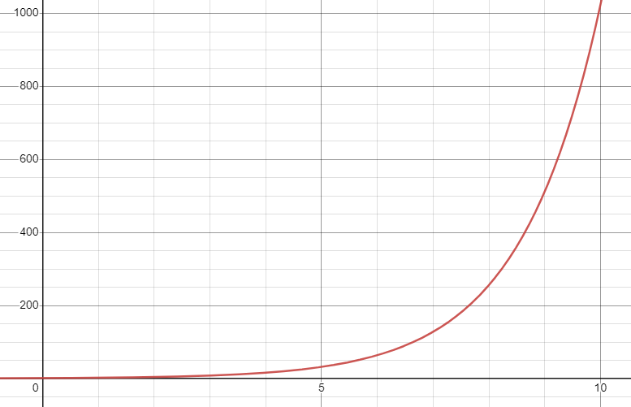
Algorithm #4: Generating all possible binary combinations of length N
static void generateAllBinaryStrings(int n, int arr[], int i) {
if (i == n) {
printTheArray(arr, n);
return;
}
arr[i] = 0;
generateAllBinaryStrings(n, arr, i + 1);
arr[i] = 1;
generateAllBinaryStrings(n, arr, i + 1);
}
N
# Of binary digits generated
1 | 2
2 | 4
3 | 8
4 | 16
5 | 32
8 | 256
16 | 65536
# Of binary digits generated
N
N = length of binary digits

Slide 93
Algorithm #4: Generating all possible binary combinations of length N
static void generateAllBinaryStrings(int n, int arr[], int i) {
if (i == n) {
printTheArray(arr, n);
return;
}
arr[i] = 0;
generateAllBinaryStrings(n, arr, i + 1);
arr[i] = 1;
generateAllBinaryStrings(n, arr, i + 1);
}
The growth rate of this algorithm is exponential
An exponential growth rate is one where the resource needed begins to double or increase very drastically as N increases
F(x) = B ^ x
# Of binary digits generated
N

Slide 94
Algorithm #4: Generating all possible binary combinations of length N
static void generateAllBinaryStrings(int n, int arr[], int i) {
if (i == n) {
printTheArray(arr, n);
return;
}
arr[i] = 0;
generateAllBinaryStrings(n, arr, i + 1);
arr[i] = 1;
generateAllBinaryStrings(n, arr, i + 1);
}
The growth rate of this algorithm is exponential
An exponential growth rate is one where the resource needed begins to double or increase very drastically as N increases
F(x) = B ^ x
# Of binary digits generated
An algorithm that has an exponential growth rate is generally perceived as inefficient. When N gets big, sometimes the algorithm won’t finish for years
N

Slide 95
The growth rate of the algorithm looks at how much more resource an algorithm needs (time or space) as the input size increases
Constant
???
Linear
???
Quadratic
???
Exponential
???

Slide 96
Constant
Quadratic
Linear
Exponential

Slide 97
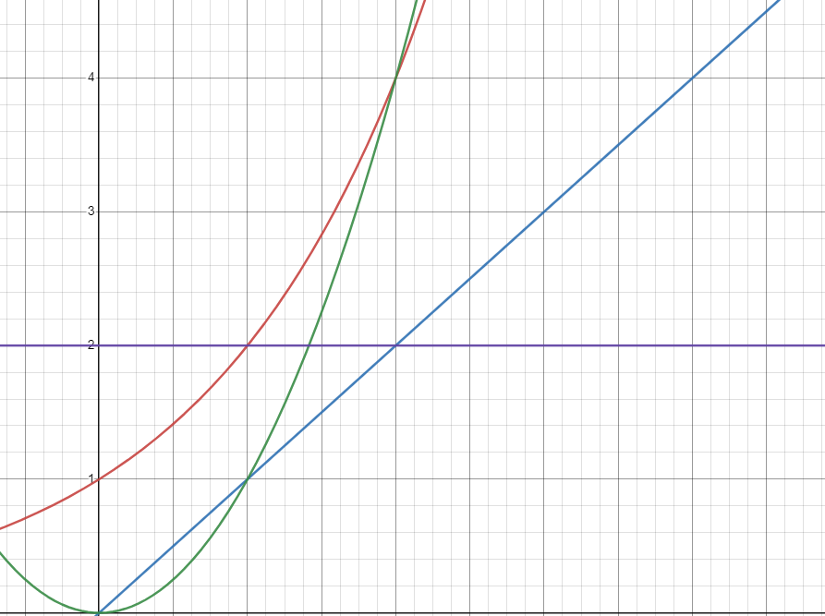
Linear
Exponential
Quadratic
Constant

Slide 98
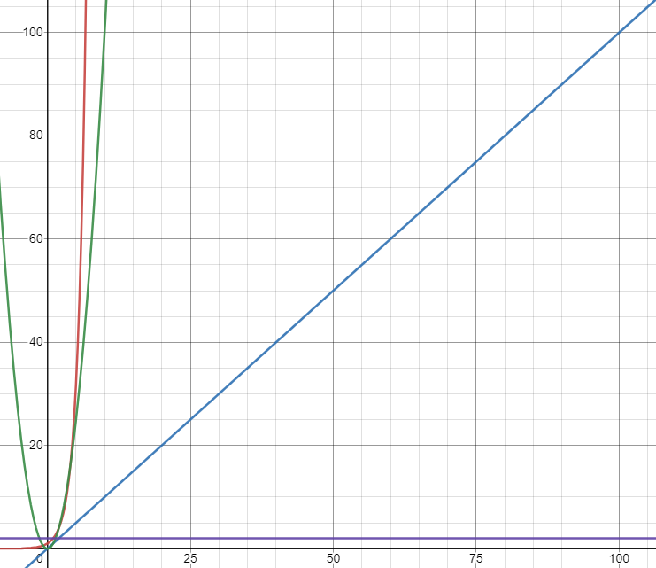

After a certain point, exponential growth rates goes crazy and beings to grow much faster than the other growth rates

Slide 99
Algorithm #5: Generating prime numbers up to N
//function to check if a given number is prime
static boolean isPrime(int n)
{
if(n==1||n==0) return false;
for(int i=2; i<=n-1; i++){
if(n%i==0)return false;
}
return true;
}
public static void main (String[] args)
{
int N = 50;
for(int i=1; i<=N; i++){
if(isPrime(i)) {
System.out.print(i + " ");
}
}
}
This algorithm generates prime numbers up to N

Slide 100
Algorithm #5: Generating prime numbers up to N
//function to check if a given number is prime
static boolean isPrime(int n)
{
if(n==1||n==0) return false;
for(int i=2; i<=n-1; i++){
if(n%i==0)return false;
}
return true;
}
public static void main (String[] args)
{
int N = 50;
for(int i=1; i<=N; i++){
if(isPrime(i)) {
System.out.print(i + " ");
}
}
}
This algorithm generates prime numbers up to N
Check all possible values up to N

Slide 101
Algorithm #5: Generating prime numbers up to N
//function to check if a given number is prime
static boolean isPrime(int n)
{
if(n==1||n==0) return false;
for(int i=2; i<=n-1; i++){
if(n%i==0)return false;
}
return true;
}
public static void main (String[] args)
{
int N = 50;
for(int i=1; i<=N; i++){
if(isPrime(i)) {
System.out.print(i + " ");
}
}
}
This algorithm generates prime numbers up to N
Check every possible factor of a value
Check all possible values up to N

Slide 102
Algorithm #5: Generating prime numbers up to N
//function to check if a given number is prime
static boolean isPrime(int n)
{
if(n==1||n==0) return false;
for(int i=2; i<=n-1; i++){
if(n%i==0)return false;
}
return true;
}
public static void main (String[] args)
{
int N = 50;
for(int i=1; i<=N; i++){
if(isPrime(i)) {
System.out.print(i + " ");
}
}
}
This algorithm generates prime numbers up to N
How many factors do we check given N?

Slide 103
Algorithm #5: Generating prime numbers up to N
static int counter= 0;
//function to check if a given number is prime
static boolean isPrime(int n)
{
if(n==1||n==0) return false;
for(int i=2; i<=n-1; i++){
counter++;
if(n%i==0)return false;
}
return true;
}
public static void main (String[] args)
{
int N = 50;
for(int i=1; i<=N; i++){
if(isPrime(i)) {
System.out.print(i + " ");
}
}
System.out.println();
System.out.println(counter);
}
Let’s add a counter!

Slide 104
Algorithm #5: Generating prime numbers up to N
static int counter= 0;
//function to check if a given number is prime
static boolean isPrime(int n)
{
if(n==1||n==0) return false;
for(int i=2; i<=n-1; i++){
counter++;
if(n%i==0)return false;
}
return true;
}
public static void main (String[] args)
{
int N = 50;
for(int i=1; i<=N; i++){
if(isPrime(i)) {
System.out.print(i + " ");
}
}
System.out.println();
System.out.println(counter);
}
Let’s add a counter!
N | Counter
1 | 0
3 | 1
8 | 12
10 | 15
20 | 74
50 | 350

Slide 105
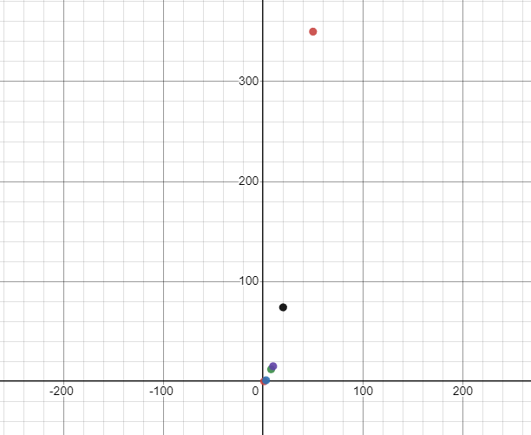
Algorithm #5: Generating prime numbers up to N
This looks to be quadratic

Slide 106
Algorithm #6: Brute Forcing an N digit numeric passcode
public static void main(String[] args) {
int n = 4; //0 - 9999
int upperbound = 1;
for(int i = 0; i < n; i++) {
upperbound *= 10;
}
for(int i = 0; i < upperbound; i++ ) {
guess(i); //guess a password
}
}

Slide 107


Algorithm #6: Brute Forcing an N digit numeric passcode
public static void main(String[] args) {
int n = 4; //0 - 9999
int upperbound = 1;
for(int i = 0; i < n; i++) {
upperbound *= 10;
}
for(int i = 0; i < upperbound; i++ ) {
guess(i); //guess a password
}
}
This for loop grows linearly

Slide 108


Algorithm #6: Brute Forcing an N digit numeric passcode
public static void main(String[] args) {
int n = 4; //0 - 9999
int upperbound = 1;
for(int i = 0; i < n; i++) {
upperbound *= 10;
}
for(int i = 0; i < upperbound; i++ ) {
guess(i); //guess a password
}
}
This for loop grows linearly
???

Slide 109
Algorithm #6: Brute Forcing an N digit numeric passcode
public static void main(String[] args) {
int n = 4; //0 - 9999
int upperbound = 1;
for(int i = 0; i < n; i++) {
upperbound *= 10;
}
for(int i = 0; i < upperbound; i++ ) {
guess(i); //guess a password
}
}
N | # Passcodes Guessed
1 | 10
2 | 100
3 | 1000
4 | 10000
5 | 100000
6 | 1000000

Slide 110

Algorithm #6: Brute Forcing an N digit numeric passcode
public static void main(String[] args) {
int n = 4; //0 - 9999
int upperbound = 1;
for(int i = 0; i < n; i++) {
upperbound *= 10;
}
for(int i = 0; i < upperbound; i++ ) {
guess(i); //guess a password
}
}
N | # Passcodes Guessed
1 | 10
2 | 100
3 | 1000
4 | 10000
5 | 100000
6 | 1000000
10

Slide 111
Algorithm #6: Brute Forcing an N digit numeric passcode
public static void main(String[] args) {
int n = 4; //0 - 9999
int upperbound = 1;
for(int i = 0; i < n; i++) {
upperbound *= 10;
}
for(int i = 0; i < upperbound; i++ ) {
guess(i); //guess a password
}
}
N | # Passcodes Guessed
1 | 10
2 | 100
3 | 1000
4 | 10000
5 | 100000
6 | 1000000
10
y = 10^{^x}
Exponential

Slide 112
The growth rate of the algorithm looks at how much more resource an algorithm needs (time or space) as the input size increases
Constant
???
Linear
???
Quadratic
???
Exponential
???

